Slide 1


Prepared by: Sawandi Kirby
DELIVERY RELIABILITY & LOGISTICS COST PERFORMANCE ANALYSIS
Third-Party Logistics (3PL) Performance Review
Data Source: SCMS Delivery History Dataset
Tools: Excel, Tableau

Slide 2



Delivery reliability varies significantly by shipment mode, vendor, and geography, with clear cost–service tradeoffs.
Air shipments achieve the highest on-time performance but at materially higher cost.
SCMS-managed RDC shipments underperform relative to other vendors.
Several high-volume African countries combine elevated volume with below-average on-time delivery.
Why This Matters:
Reliability improvements are achievable, but not without cost or process tradeoffs.

Slide 3

How reliable is delivery performance across shipment modes, vendors, and countries — and what tradeoffs exist between cost and service?
Exclusions:
Shipments missing scheduled delivery dates excluded from SLA metrics
Freight and weight costs evaluated on first-line shipment records only
Scope
Shipment-level delivery records
Focus on:
On-time delivery
Delivery delay
Logistics cost efficiency

Slide 4
Key Performance Indicators
KPIs Used
Total Shipments | On-Time Delivery % | Average Delivery Delay (Days) | Total Logistics Cost | Cost per Unit.
On-Time Delivery %: Delivered on or before scheduled delivery date.
Cost per Unit: Total logistics cost ÷ units shipped.

Slide 5
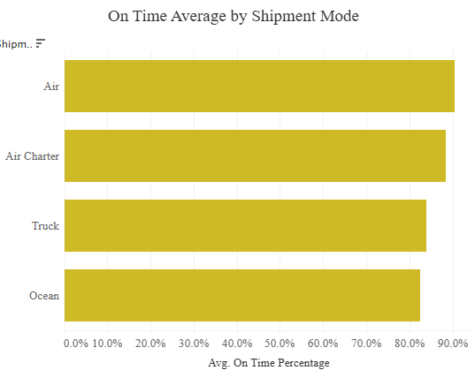
Delivery Reliability by Shipment Mode
Insight:
Shipment mode is a primary driver of delivery reliability.
What We See:
Air shipments are the most reliable
Truck and Ocean shipments show lower on-time performance
Interpretation:
Faster modes improve service levels
Reliability gains come with increased cost exposure

Slide 6
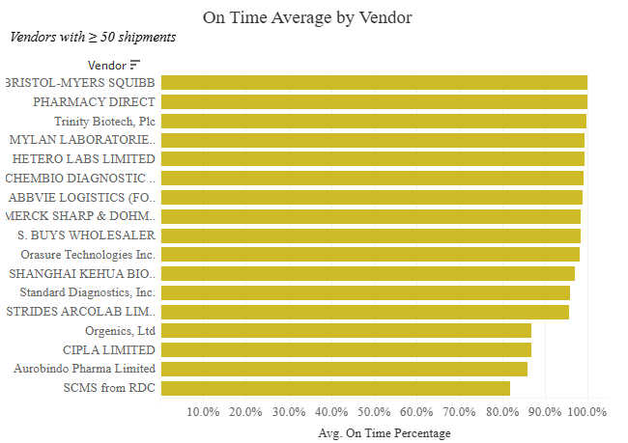
Vendor Performance Risk
Insight:
Delivery reliability varies materially by vendor.
- What We See
SCMS-managed RDC shipments exhibit lower on-time performance
Other vendors perform more consistently
Interpretation:
RDC processes may introduce operational or documentation delays
Vendor-level performance review is warranted

Slide 7
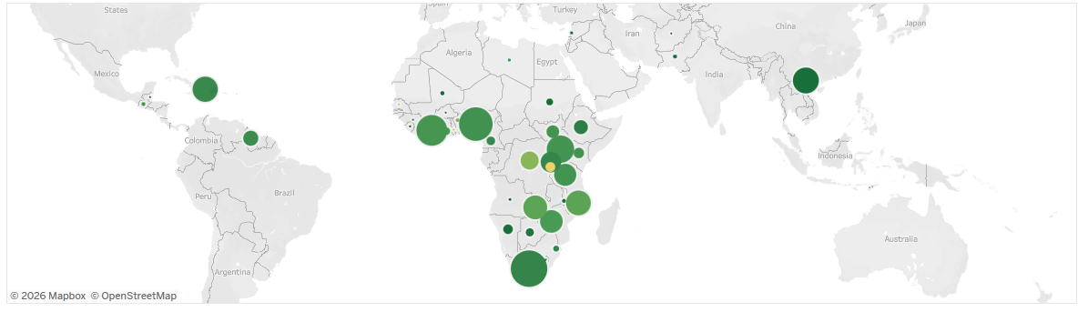
Geographic Risk Concentration
Insight:
Delivery risk is concentrated in specific high-volume countries.
What We See:
Countries such as Côte d’Ivoire, DRC, Nigeria, Tanzania, and Zambia show:
High shipment volumes
Below-average on-time delivery
Interpretation:
These lanes represent the greatest opportunity for targeted intervention

Slide 8
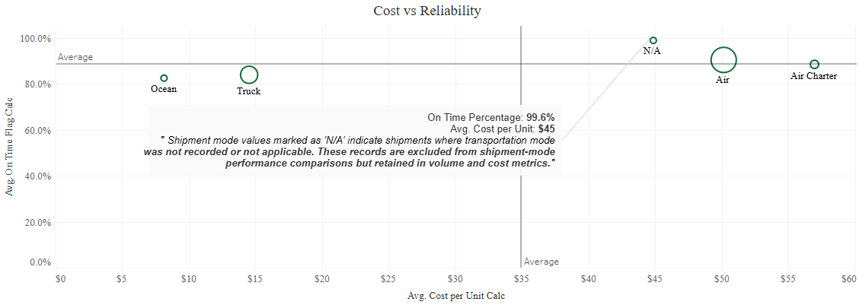


Cost vs Reliability Tradeoff
Insight:
Higher logistics spend is associated with improved reliability — but with diminishing returns.
-What We See
Air shipments cluster at higher cost and higher reliability
Lower-cost modes exhibit wider reliability variation
Interpretation:
Reliability can be “bought,” but not efficiently across all lanes
Shipment
Reliability
Cost Optimization

Slide 9

What This Means for Decision-Makers
Key Implications:
Blanket shifts to faster shipment modes are not cost-effective
Reliability improvements should be:
Selective
Lane-specific
Volume-aware
Risk Areas:
RDC-managed shipments
High-volume African delivery corridors

Slide 10



Recommendations
Use air freight selectively for:
Time-critical shipments
High-impact delivery lanes
- Review RDC processes to address reliability gaps
- Prioritize intervention in high-volume, low-performance countries

Slide 11
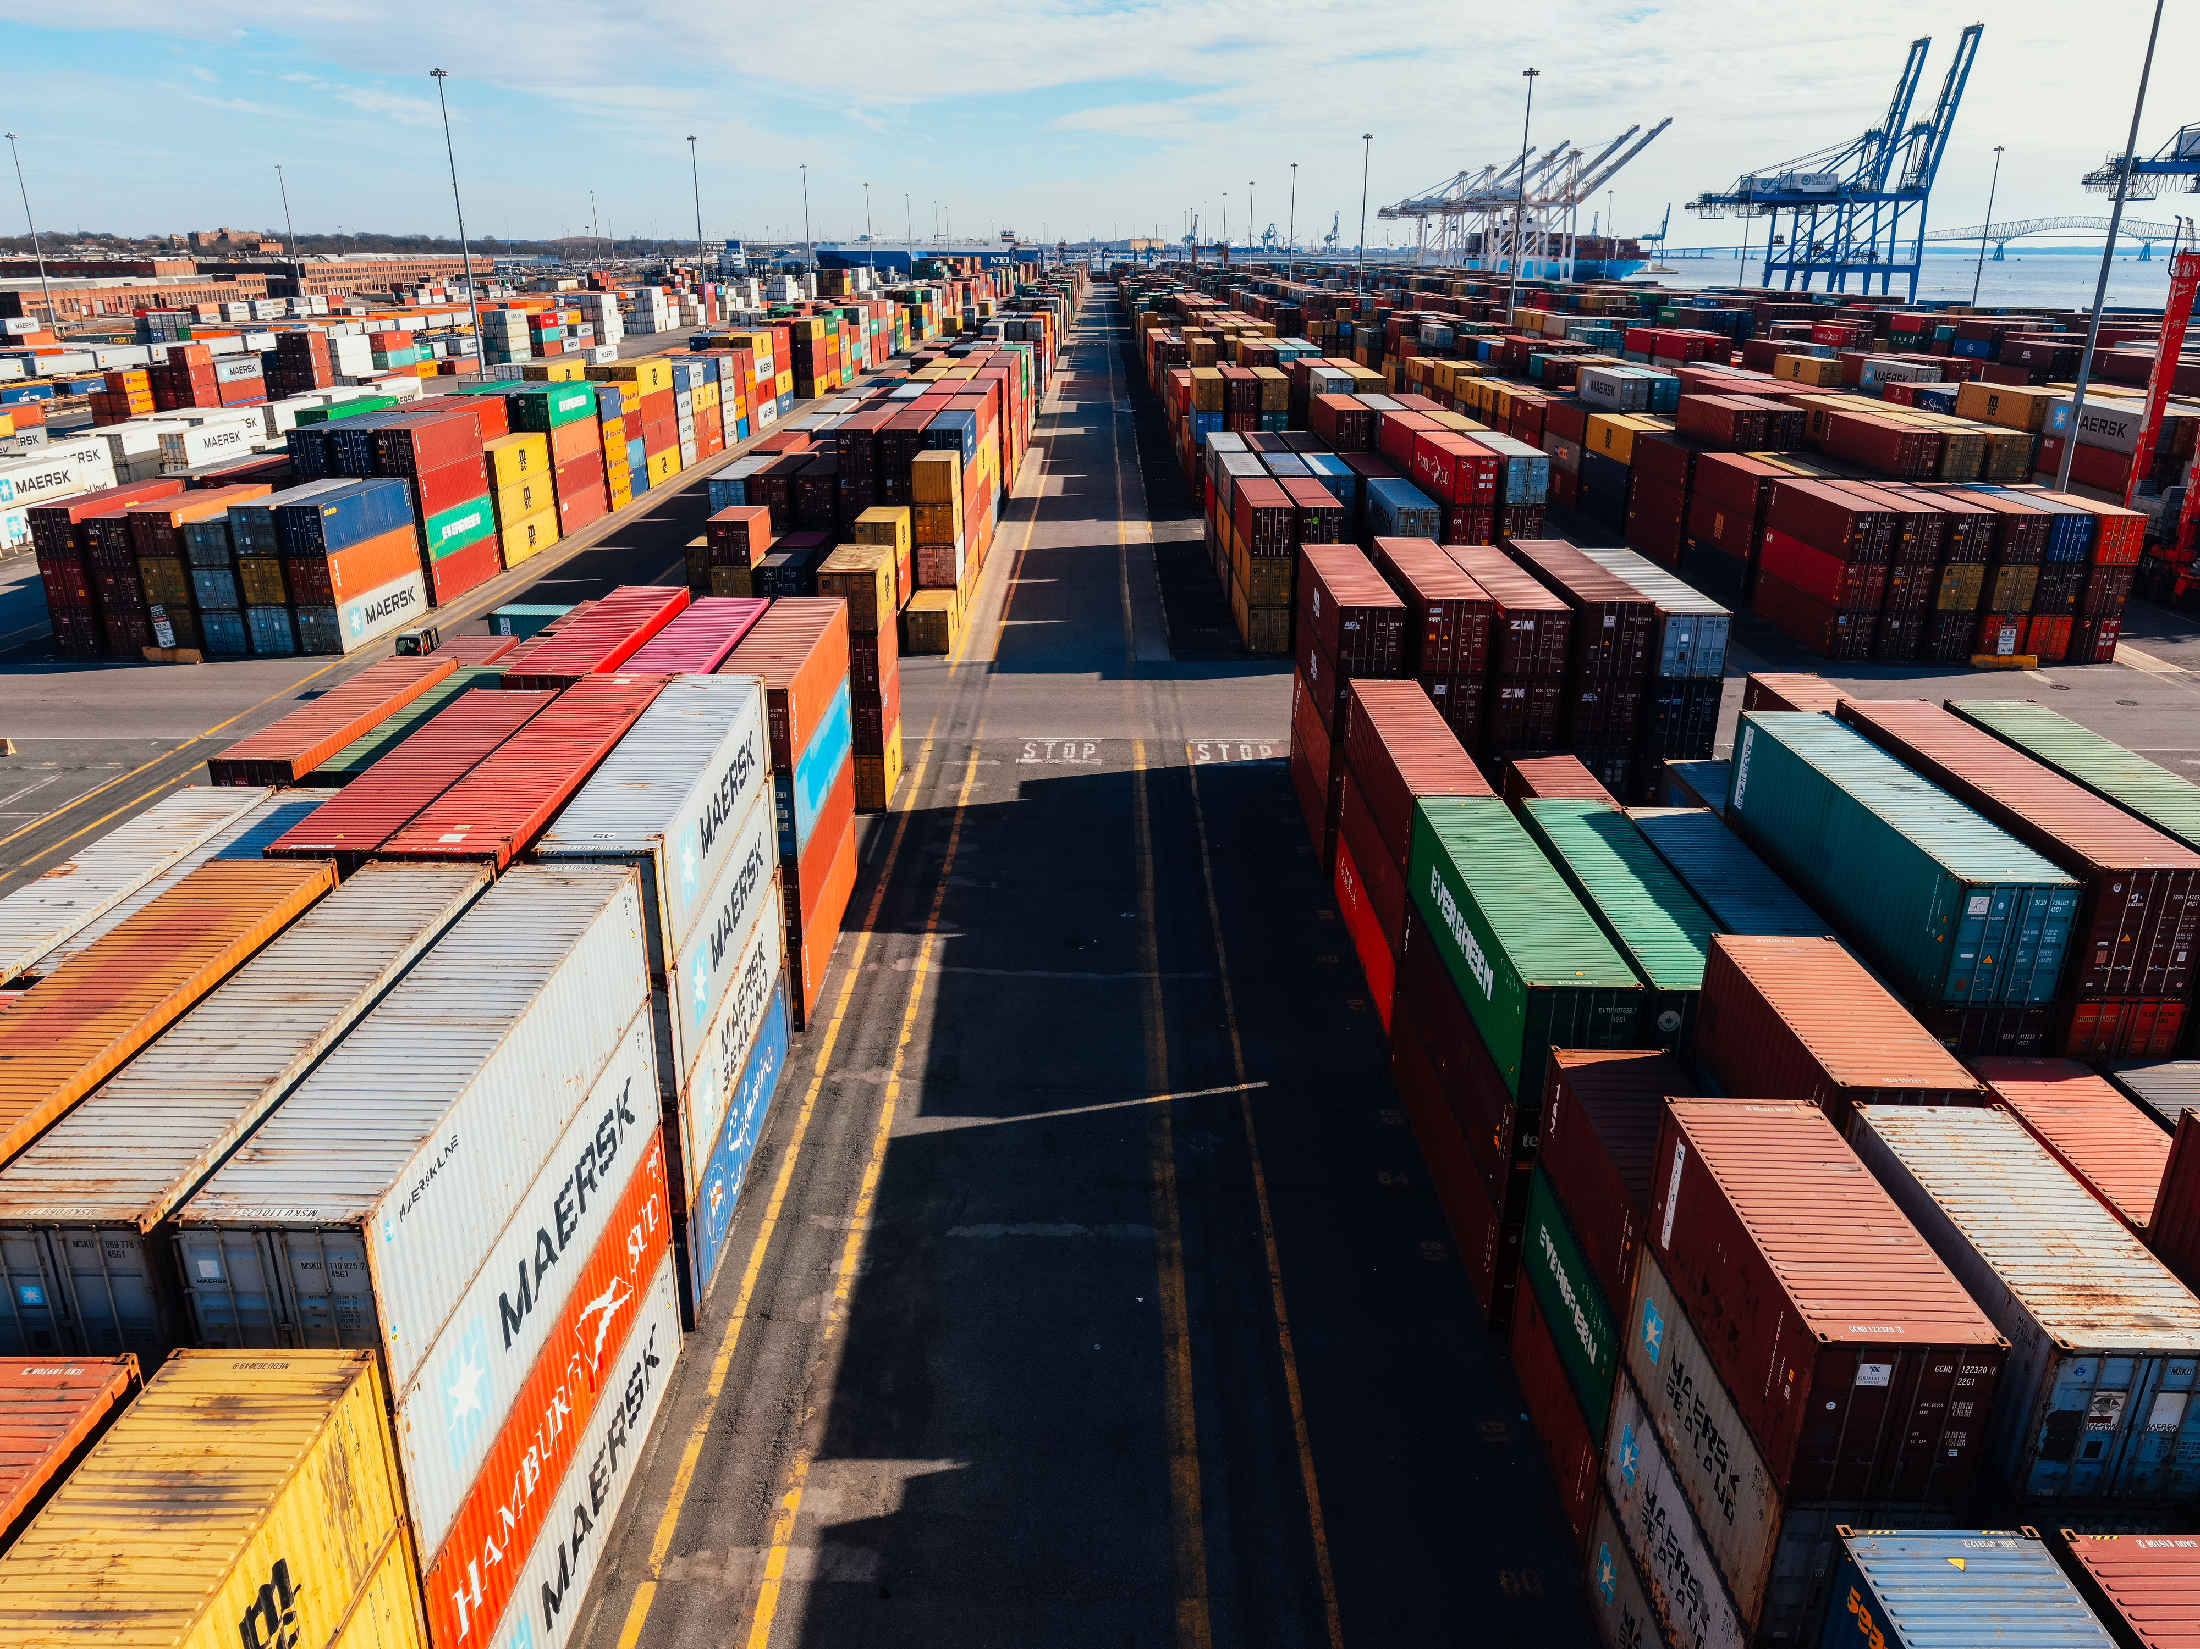
Next Steps
Short-Term:
Deep-dive into RDC operational workflows
Identify root causes of delay by country and vendor
Medium-Term:
Develop lane-based shipment mode strategies
Balance cost targets with service-level expectations

Slide 12




Sawandi Kirby
THANK YOU
CONTACTS
Linkedin.com/in/sawandi-kirby-7aa985208
Github.com/visualkirby
Skirby@visualdreamland.com
Kaggle.com/sawandikirby

